Slide 1
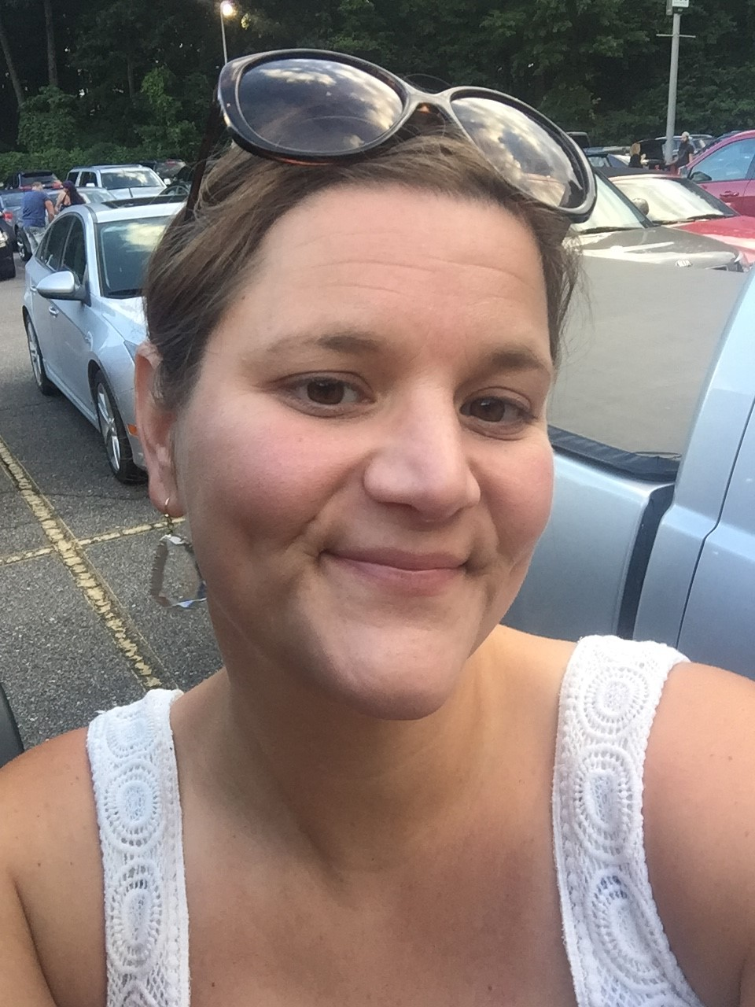

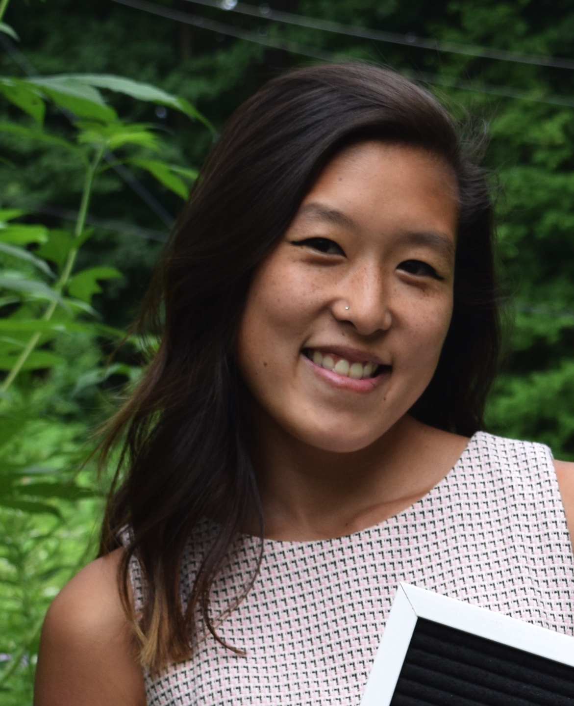

Meet the Teacher
3rd Grade
Mrs. Young
5 Fun Facts
1. I have two sons: 9 and 6 years old.
2. I went to MSU.
3. I LOVE Dogs! I have a dog named Rezna.
4. I have been teaching for over 20 years.
5. I love teaching and making lasting relationships with my students.
Fourth Grade
Ms. Lupu
5 Fun Facts
Teaching has always been my dream job!
I went to MSU!
I love to travel!
My favorite food is pasta, I could eat it everyday!
I love to play sports. I coached soccer and volleyball too!

Slide 2
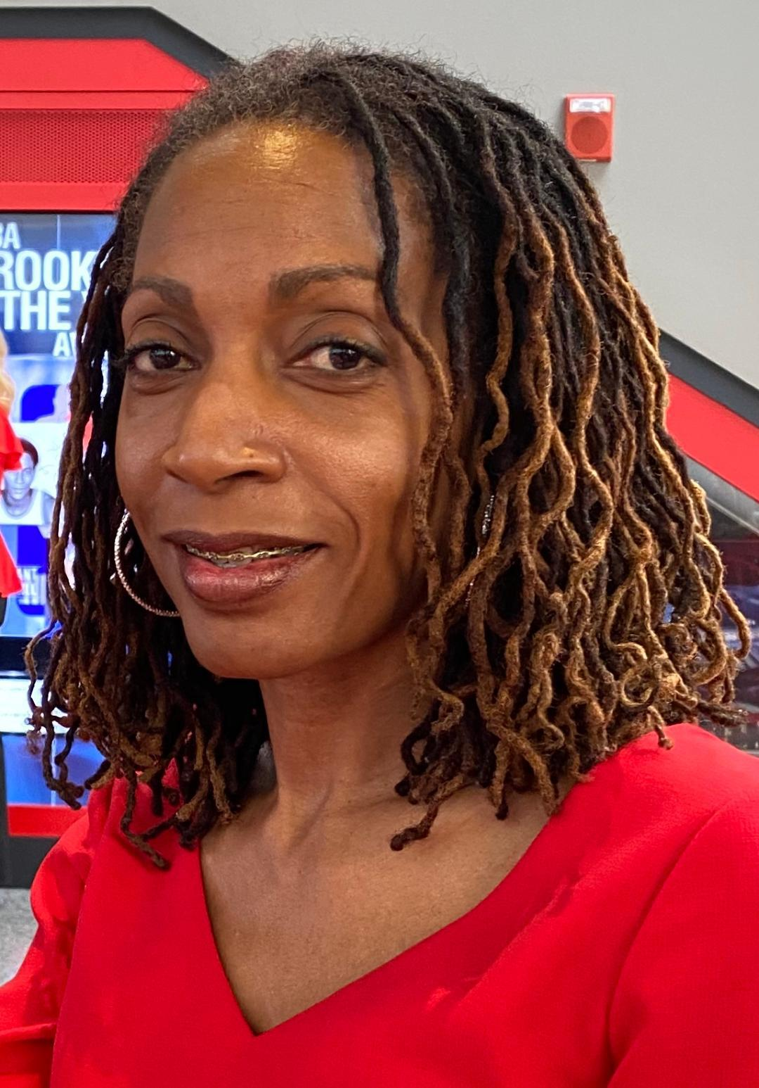

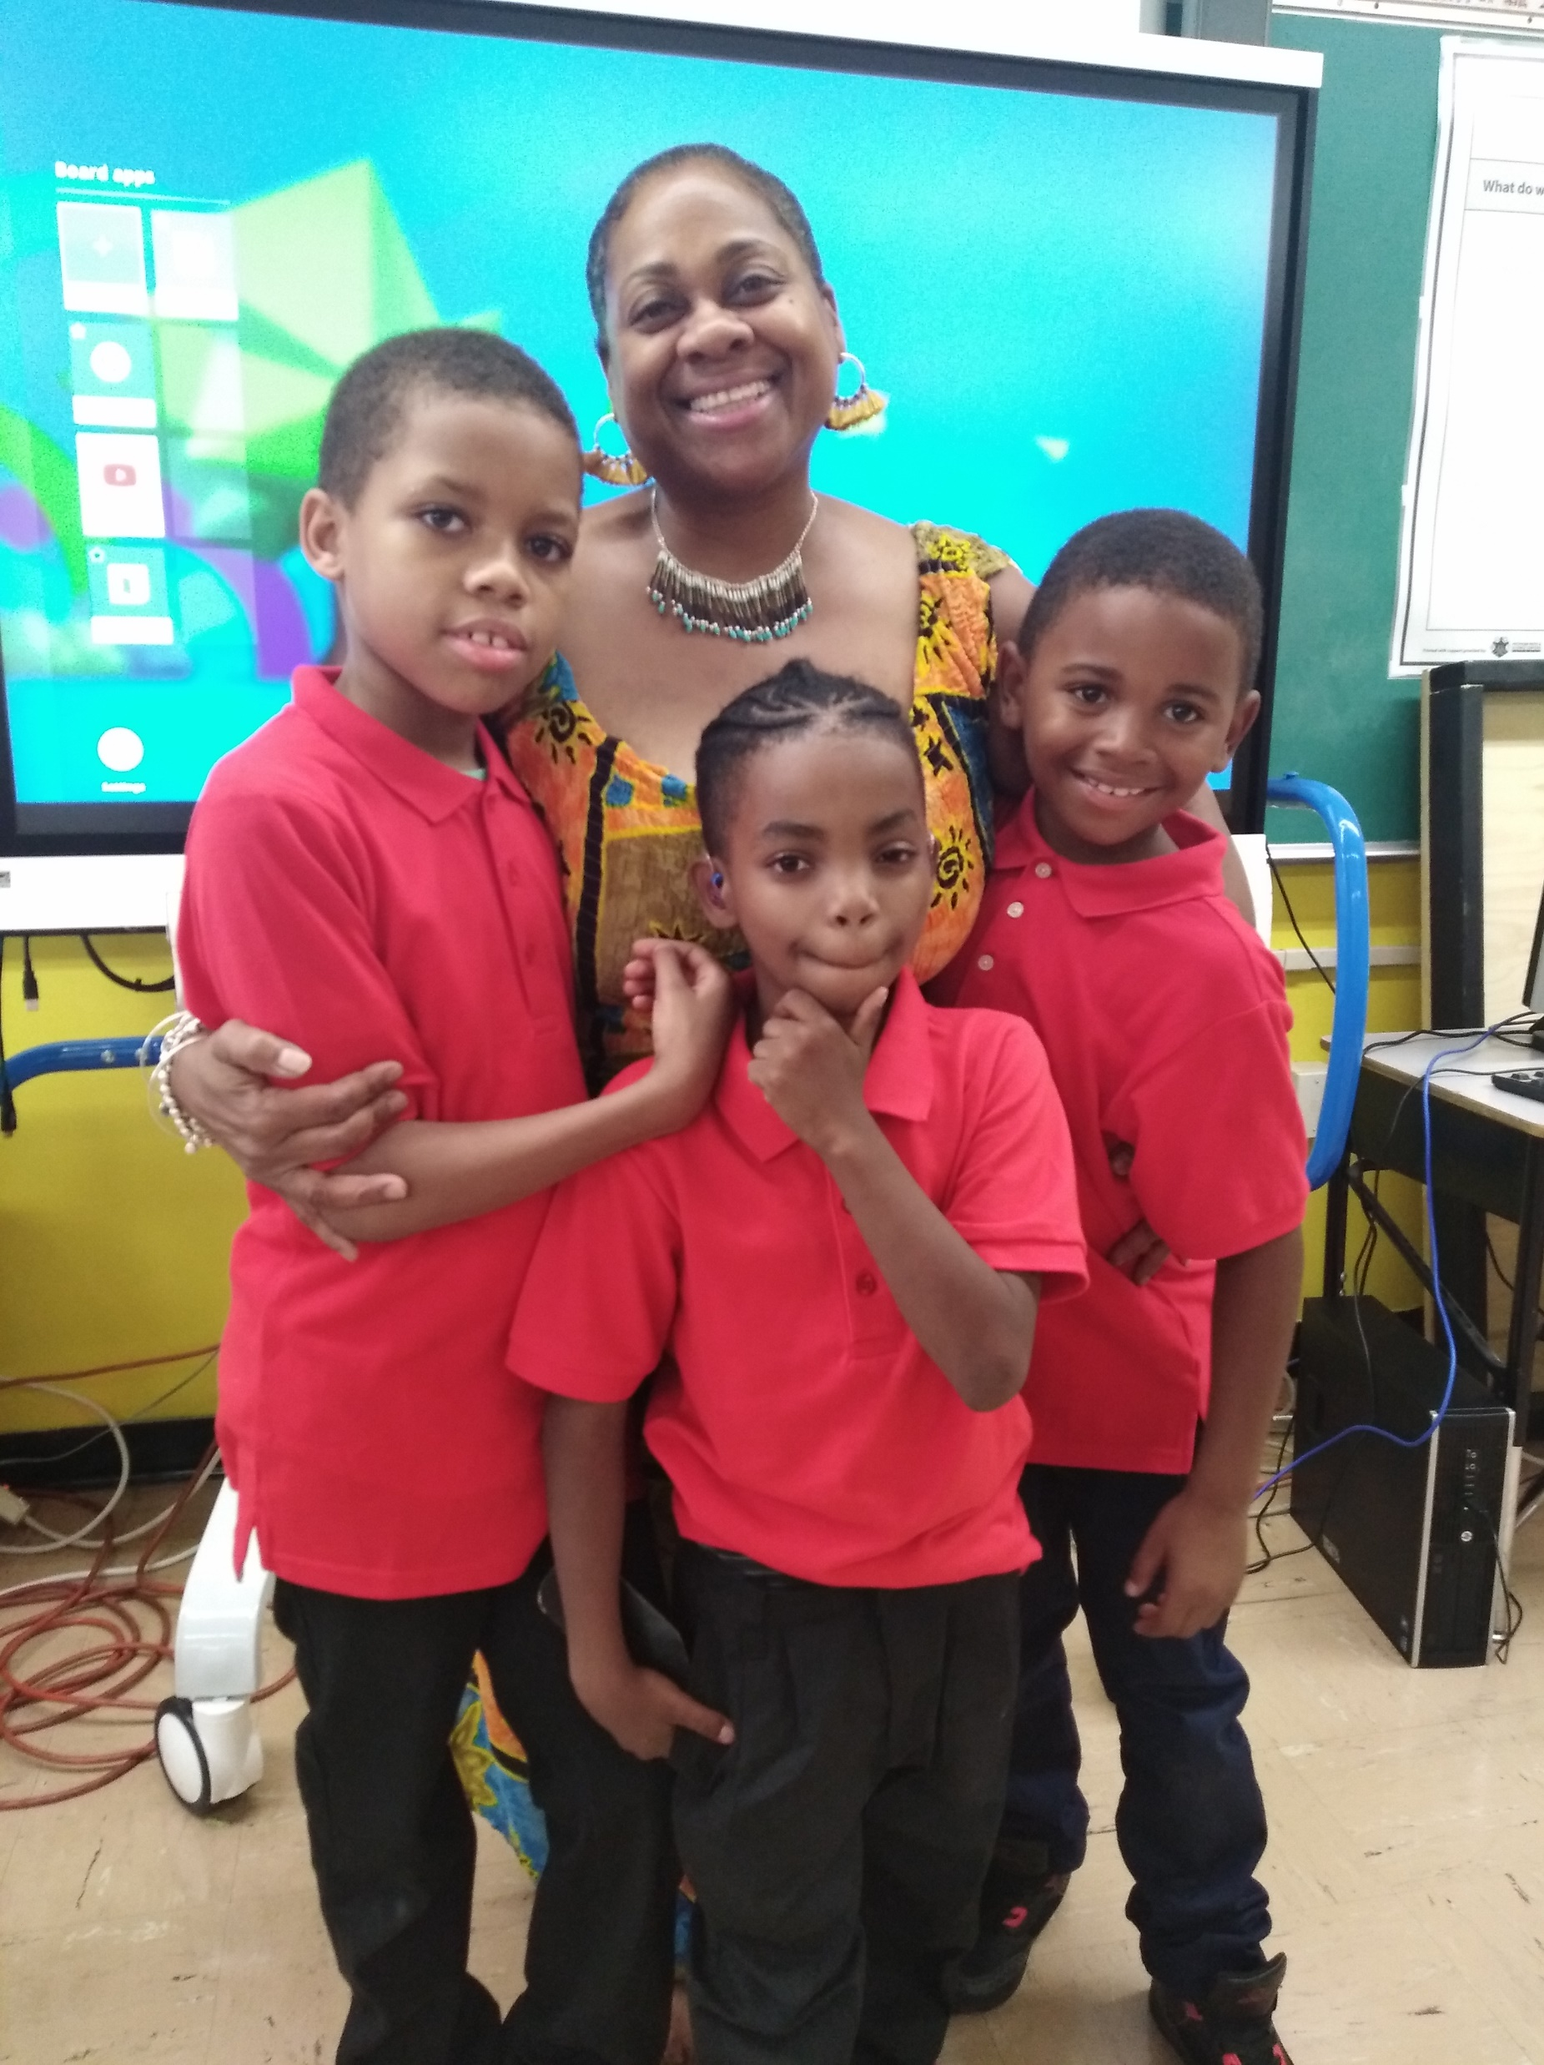

5th Grade SCHOLARS
FAILURE IS NOT AN OPTION!
Mrs. (Creagh) Russell
ELA and Social Studies
5 Fun Facts
1. I love taking long walks (rain or shine).
2. I went to Wayne State University.
3. I am married with three daughters.
4. I have been teaching for over 25 years in DPSCD.
5. I hope to someday write a novel .
Mrs. Johnson
Math and Science
5 Fun Facts
1. MASTER TEACHER
2. MATHEMATICS/SCIENCE
3. I LOVE MY STUDENTS
4. I HAVE HIGH EXPECTATIONS
5. I BELIEVE MY SCHOLARS ARE
THE BEST AND THE
BRIGHTEST!

Slide 3
Schedule
7:30-7:40 Breakfast/DO NOW and Social Emotional Learning
7:40-8:50 Literacy-Whole Class: Module Lessons
8:50-9:20 Literacy ALL Block/Small Group
9:20-10:20 Intervention Groups and Social Studies
10:20-11:05 Recess/Lunch
11:10-12:10 Math- Whole Class
12:10-12:40 Math- Small Groups/ZEARN/I-Ready
12:40-1:30 3rd/4th Gym and Music: Office Hours
5th Science
1:30-2:30 3rd/4th Science and Social Studies
5th Gym and Music: Office Hours

Slide 4




Pay attention and participate
Pay attention and participate
Pay attention and participate
Type questions in the chat so you don’t interrupt class.
Type questions in the chat so you don’t interrupt class.
Type questions in the chat so you don’t interrupt class.
Raise your hand using the icon.
Raise your hand using the icon.
Raise your hand using the icon.
Use appropriate language, kind and respectful words.
Use appropriate language, kind and respectful words.
Use appropriate language, kind and respectful words.
Leave the meeting when class is over.
Leave the meeting when class is over.
Leave the meeting when class is over.

